Slide 1
Basic Python Concept Needed for Raspberry Pi Programming
Vraj Suratwala
Department of ICT, VNSGU

Slide 2
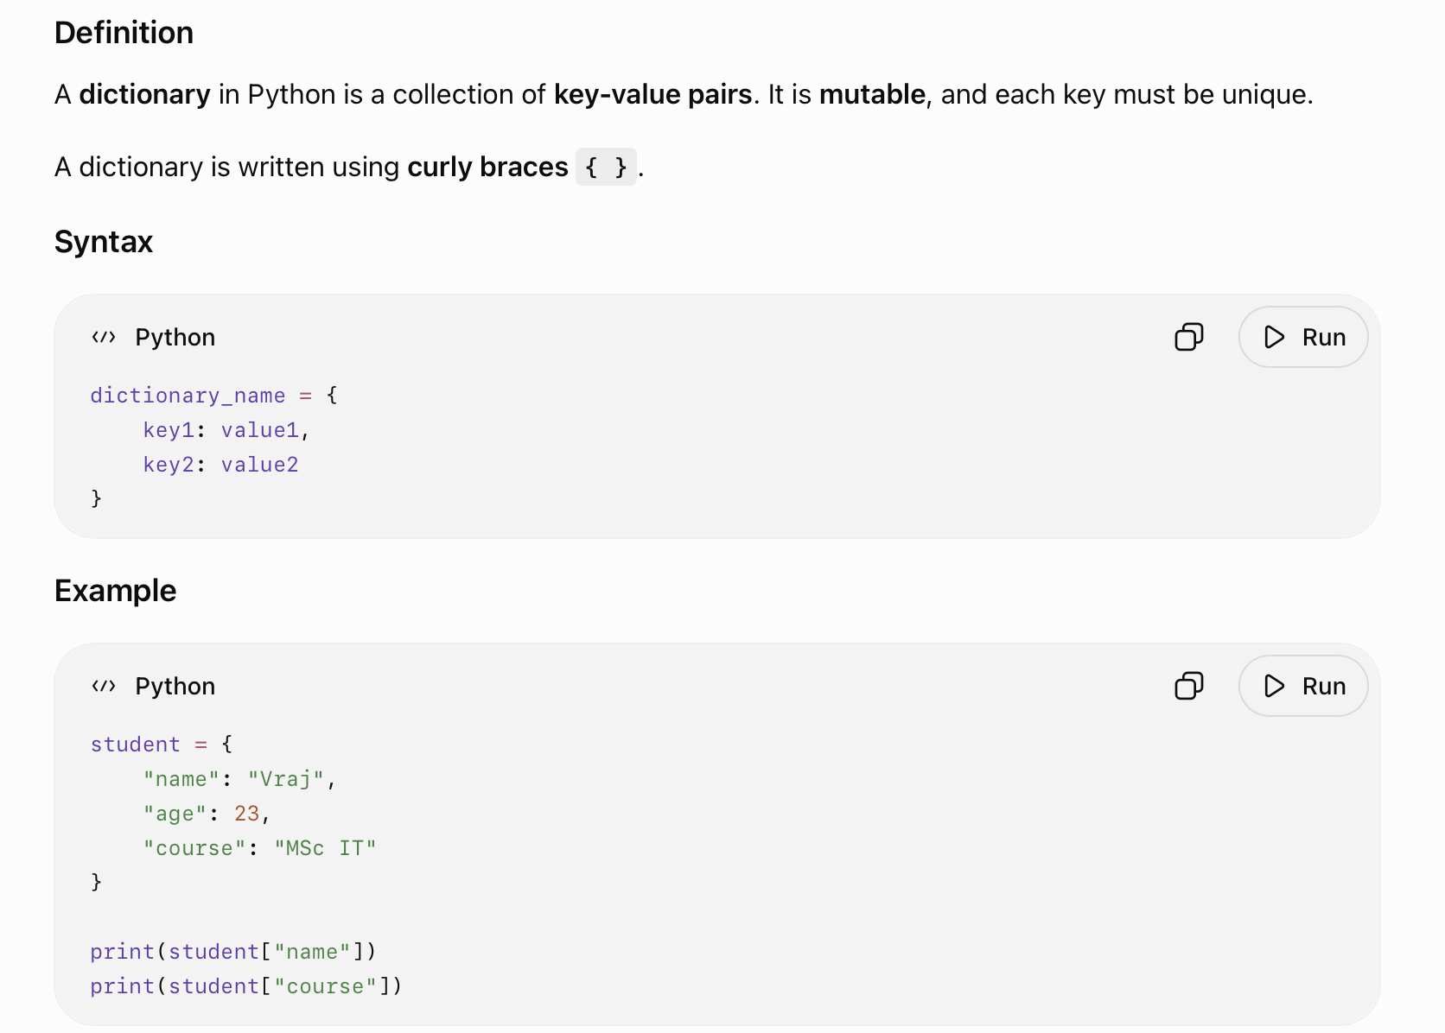
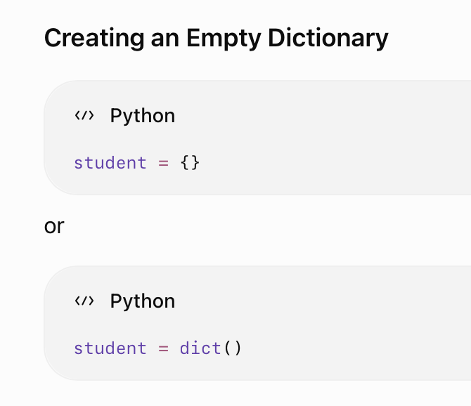
Dictionary in Python

Slide 3
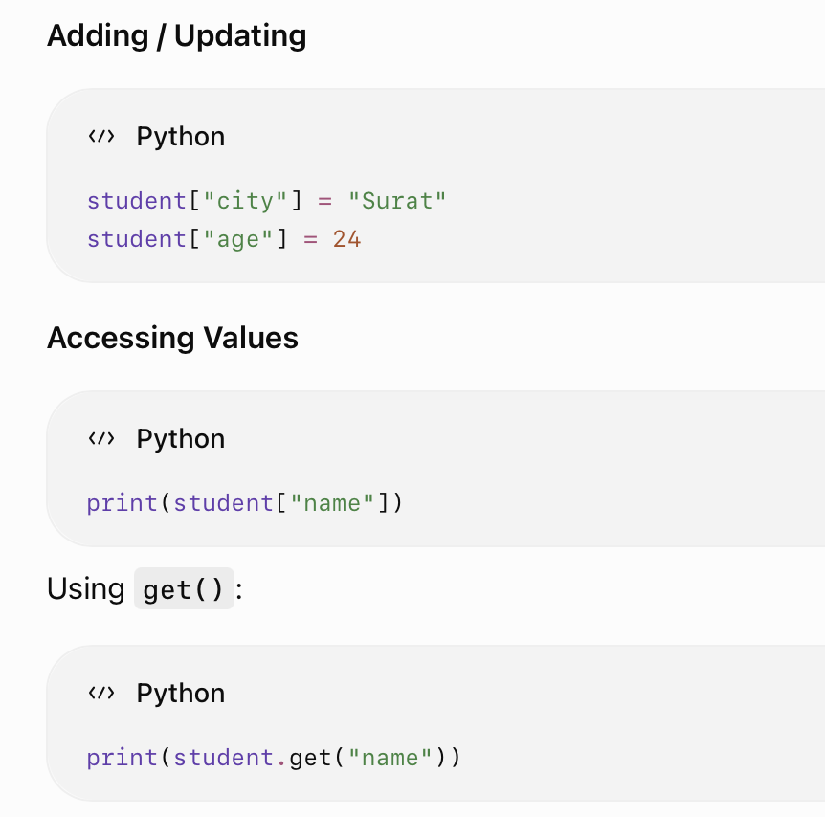
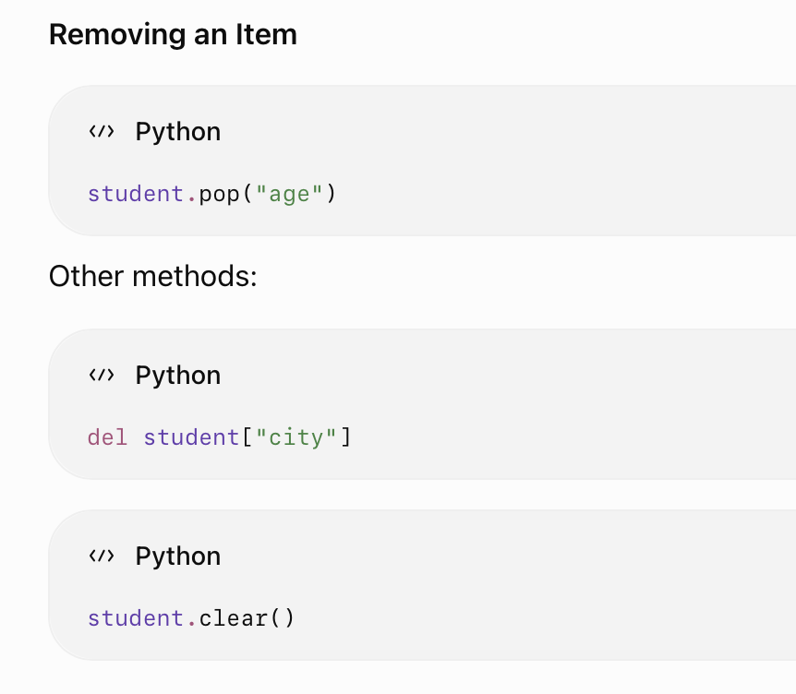

Slide 4
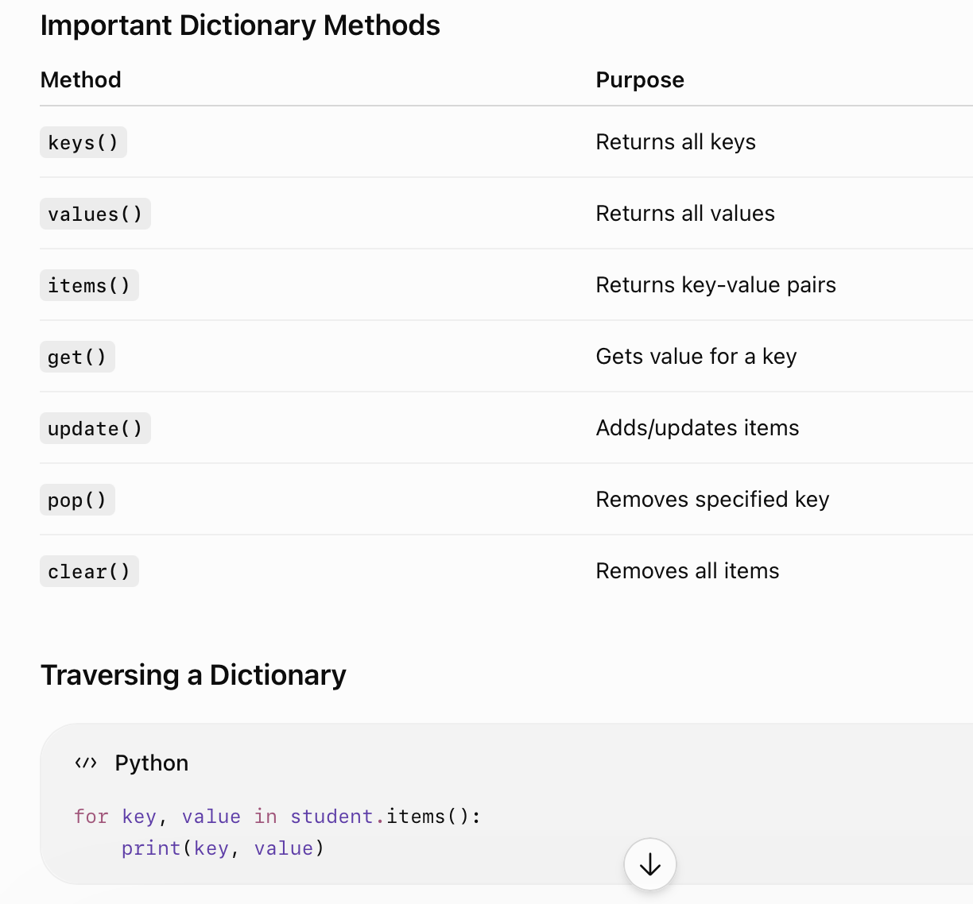

Slide 5
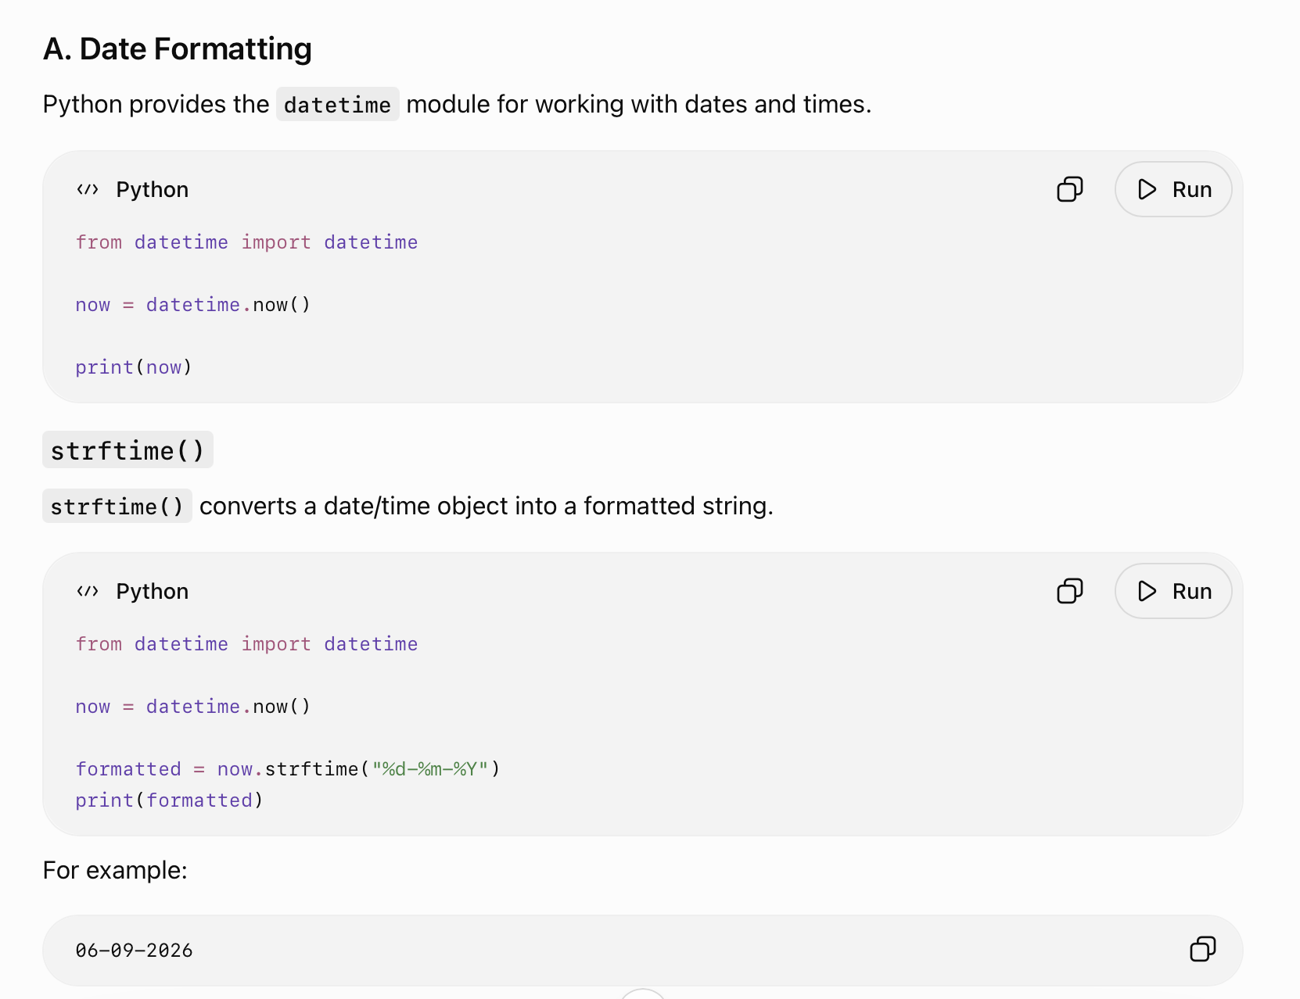
Date & Number Formatting in Python

Slide 6
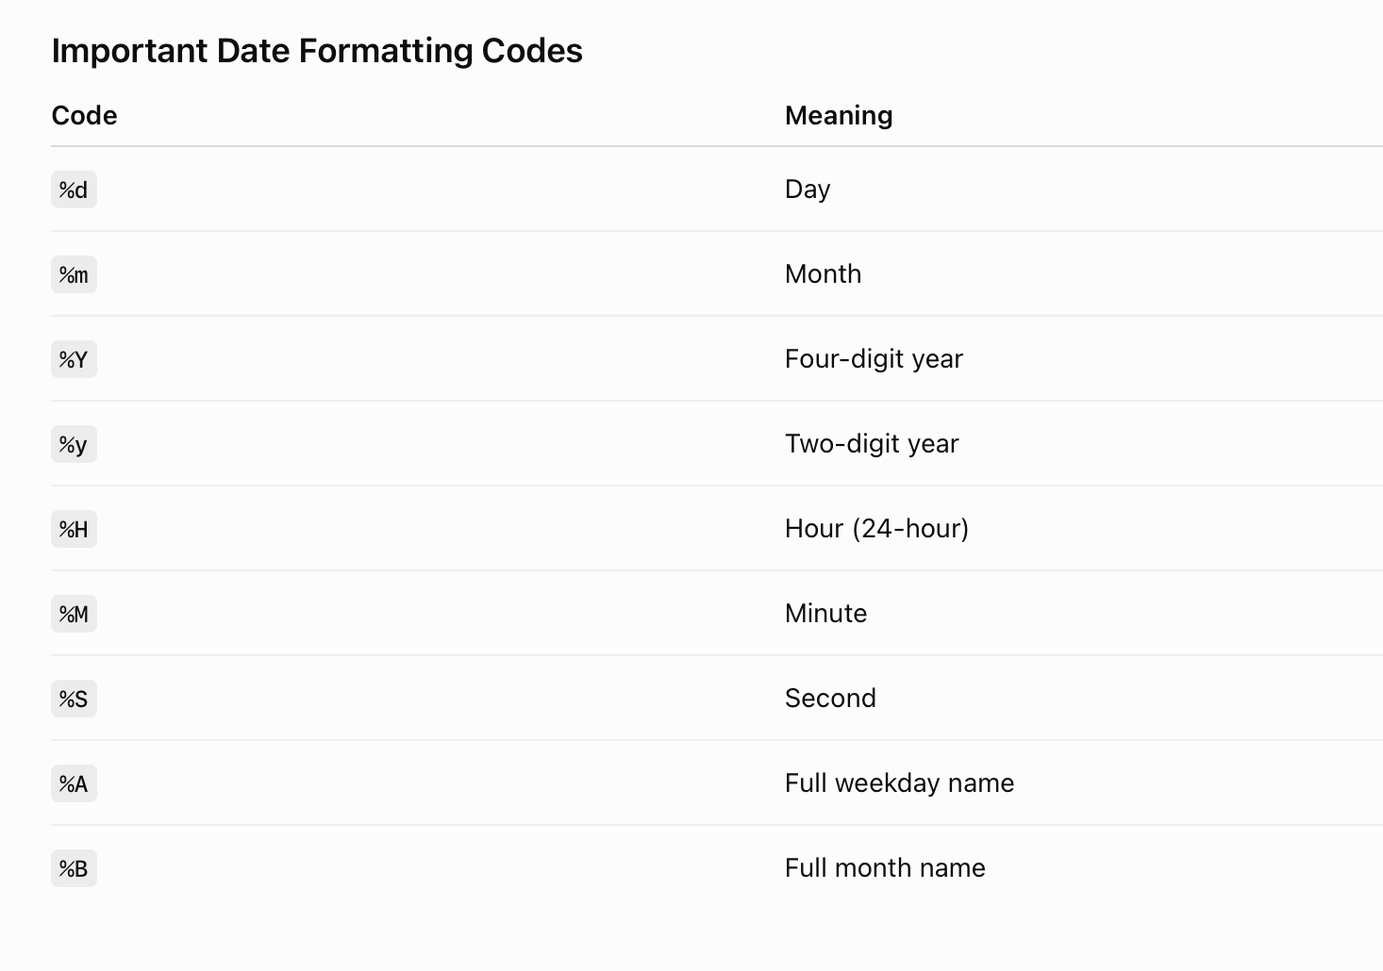
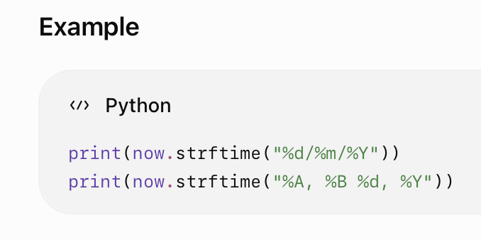
IMP

Slide 7
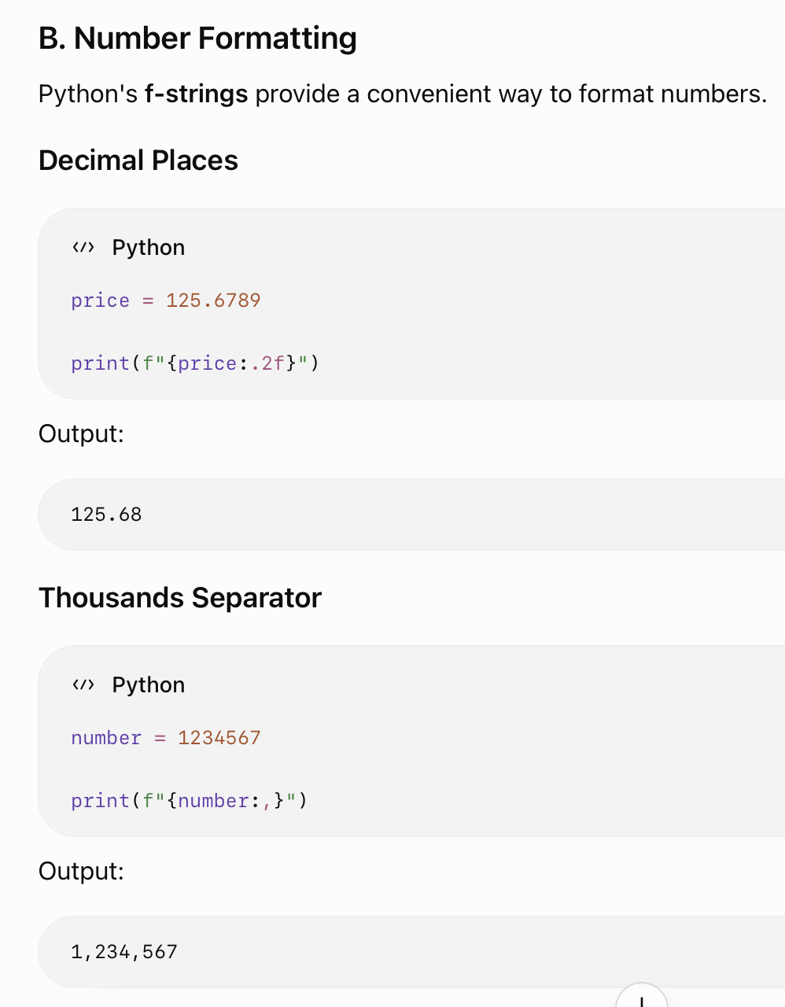
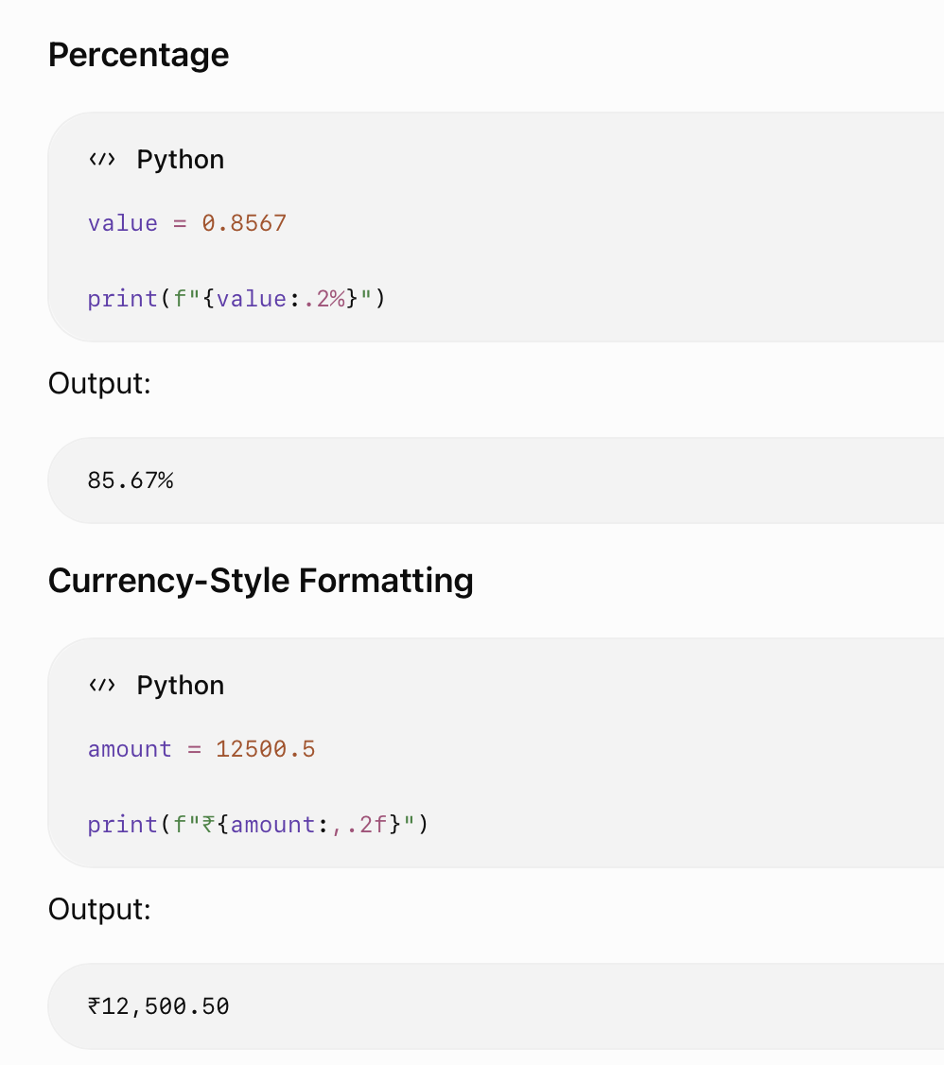

Slide 8
Command Line Arguments in Python
Command-line arguments are values supplied to a Python program when the program is executed from the command line.
They allow users to provide input without modifying the program's source code.
Python provides the sys module to access command-line arguments.
  Allows dynamic input.
  Useful for automation and scripting.
  Avoids hard-coding input values.
  Useful for executing programs with different parameters.

Slide 9
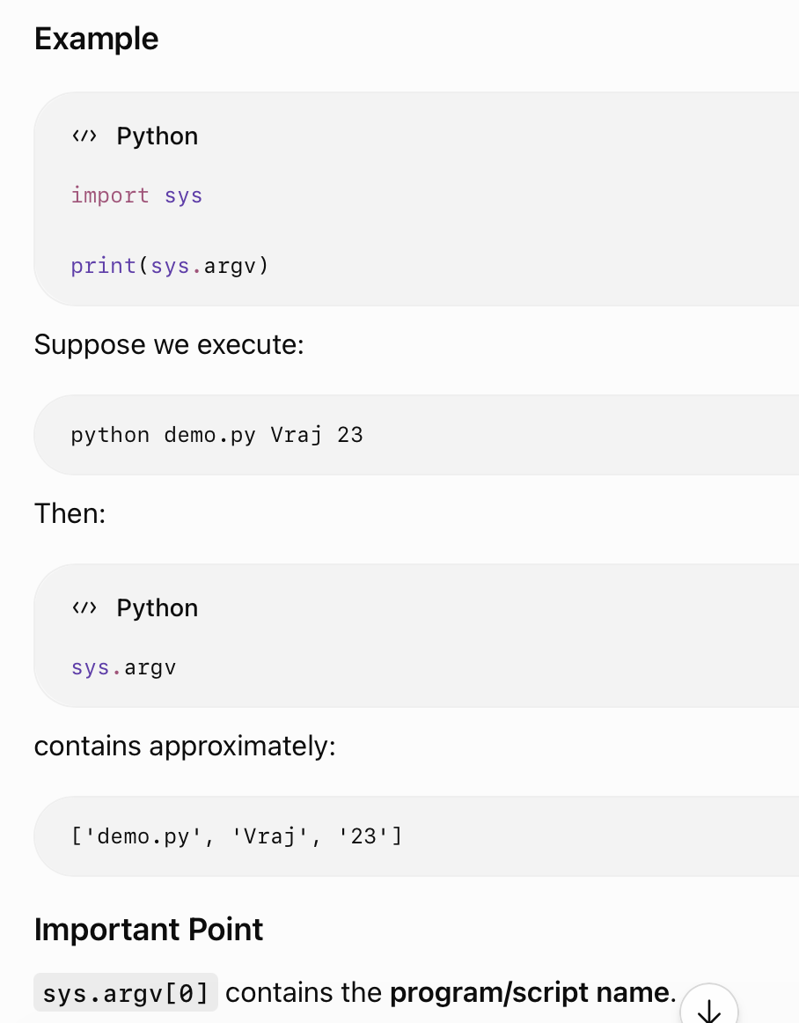
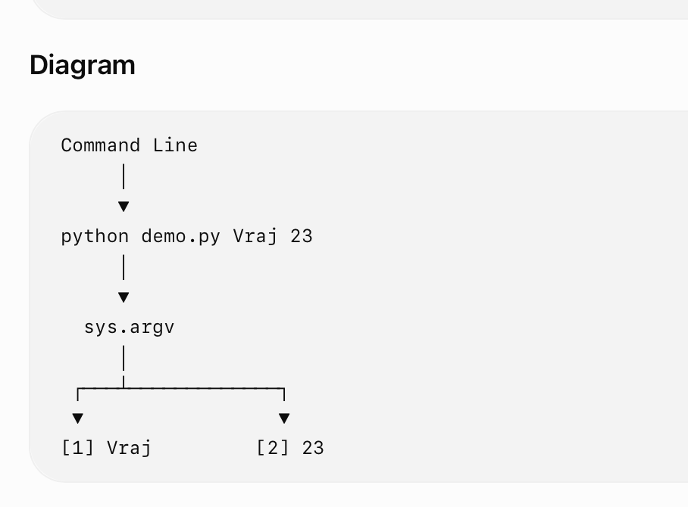

Slide 10
File Handling in Python
File handling refers to the process of creating, opening, reading, writing, updating, and closing files using a Python program.
Python provides the built-in open() function for file handling.
Opening a File
  Syntax
  open(filename, mode)
  Example:
  file = open("data.txt", "r")

Slide 11
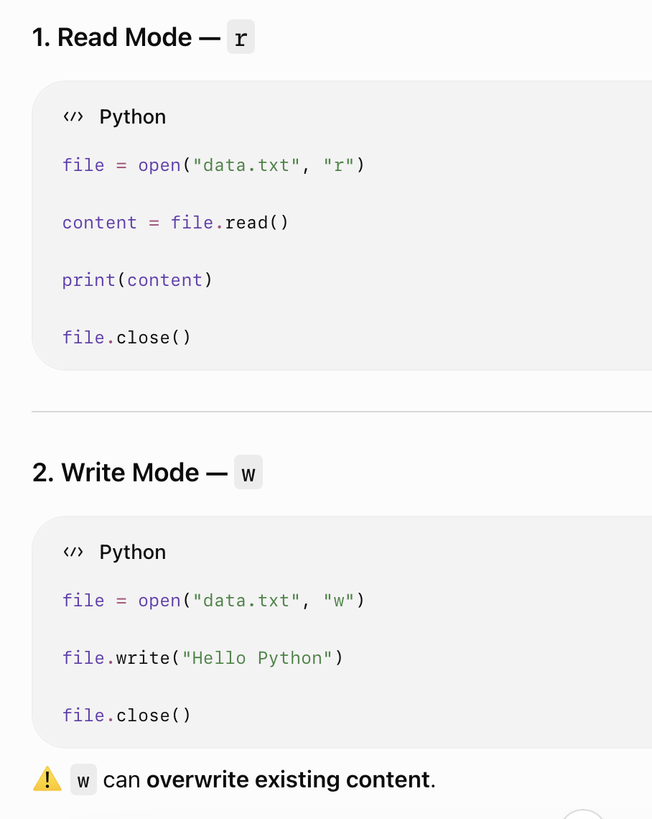
File Opening Modes
Mode Meaning
r Read
w Write
a Append
x Create a new file
r+ Read and write
b Binary mode
t Text mode

Slide 12
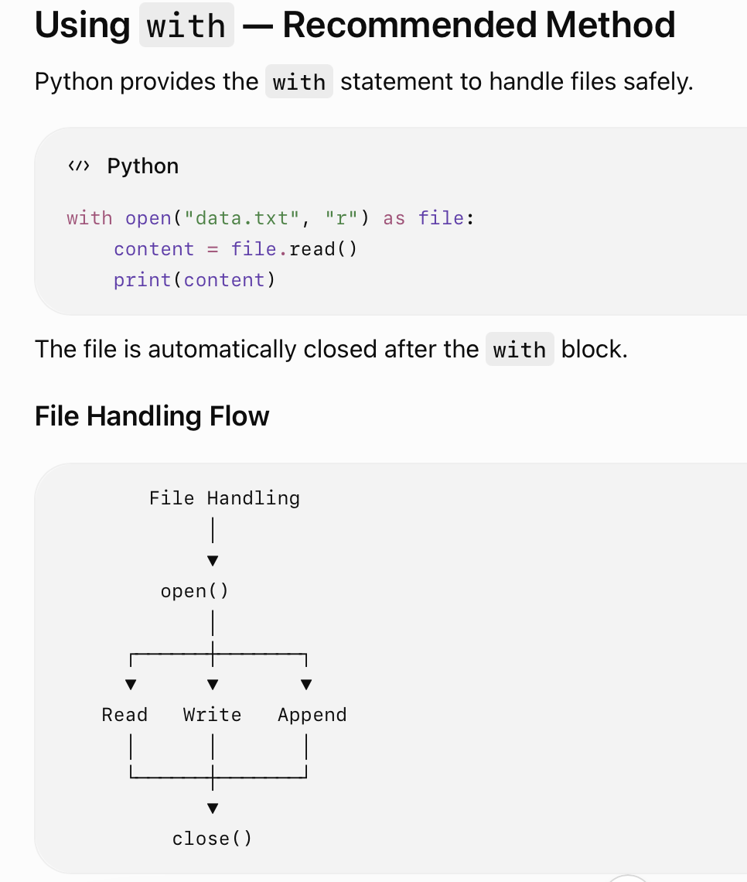
Reading Methods
read()
  Reads the entire file.
  file.read()
readline()
  Reads one line.
  file.readline()
readlines()
  Reads all lines and returns them as a list.
  file.readlines()

